Slide 1
Products Presentation.

Slide 2
America’s Health Challenges..

Slide 3
Obesity In America
The U.S. Surgeon General report declared that obesity is responsible for 300,000 deaths every year.
3.8 million Americans carry over 300 pounds
With the average adult woman weighing in at a staggering 163 pounds
400,000 Americans (mostly men) fall into a super-massive 400+ pound category

Slide 4
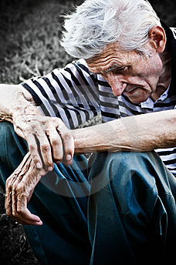
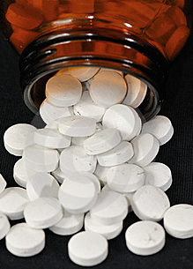
Addiction To Pain Pills
More prescriptions are being written, with less thorough understanding of the patient’s physical condition, than ever, and under those circumstances, it is not surprising that prescription drug abuse, according to the most recent prescription drug addiction statistics, is on the rise.
The US Department of Health and Human Services, in its latest publication of prescription drug addiction statistics, has both pinpointed those over sixty as the group among whom prescription drug abuse is the highest.
OVER 70 MILLION PEOPLE ARE ABUSING PRESCRIPTION MEDICATION!

Slide 5
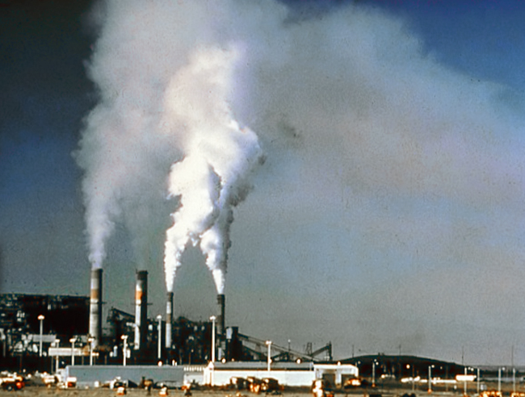
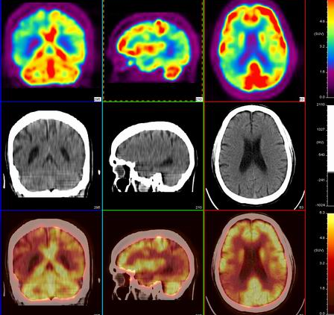
Toxins
It is common knowledge that 80% to 90% of most chronic health conditions are triggered by toxins.
Toxins are carcinogens which cause damage to our DNA, and brain function, cause cells to divide faster than their normal rate, thus causing all kinds of cancer, as well as neurological disorders.

Slide 6
America’s Economy
The jobless rate in the United States is skyrocketing and is now 6% higher than it was before the recession of 2001. Not good, and downright dangerous
Manufacturing jobs have shed over 212,000 jobs in the past year.
The Financial Services industry has shed over 79,000 in the past year.
And that’s only two industries.

Slide 7
We Have The Solution..

Slide 8
Introducing
Wellness
An Innovative Health & Wellness Foundation

Slide 9
Who is Wellness ?
Wellness in owned by a six year services company
Based in India
Innovative Wellness Foundation with premiere life changing wellness products

Slide 10
The Opportunity...
As a Wellness distributor you will have the opportunity to feel great while earning extra income simply by sharing our unique product line with others

Slide 11
Our Products.
Scalar Energy Pendant
Our natural Mineral energy pendant, is made from volcanic lava, including over 70 minerals and fused together by Japanese technology.
Based on the latest discovery in quantum science
Discovered in the 1800’s
Perfected in the 20th century

Slide 12
Our Products.
Scalar Energy Pendant Can Help Reduce:
Migraine headaches
Depression
Low metabolic rates

Slide 13
Our Products.
Scalar Energy Pendant Can Help Reduce:
Hypertension or High Blood Pressure
Arthritic, joint aches and pains
Hair loss

Slide 14
Our Products.
Scalar Energy Pendant Can Help Reduce:
Diabetic conditions
Insomnia
EMF- Cellular Phone Radiation
And much more..

Slide 15
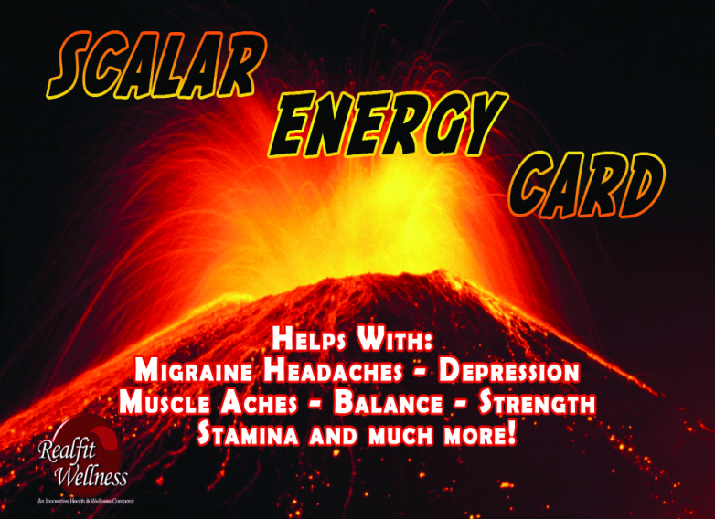
Our Products.
Scalar Energy Card tm
Our Scalar Card is thinner than the Scalar Energy Pendant making it more flexible for use
Can be used to Energize your water giving you internal Scalar Health Benefits

Slide 16
Our Products.
Scalar Energy Card tm
Can be placed under pillow for sound sleep
Can be carried in your purse or wallet

Slide 17
Our Products.
Scalar Energy Card Can Help Reduce:
Migraine headaches
Depression
Low metabolic rates
Hypertension or High Blood Pressure

Slide 18
Our Products.
Scalar Energy Card Can Help Reduce:
Arthritic, joint aches and pains
Hair loss
Cataracts

Slide 19
Our Products.
Scalar Energy Card Can Help Reduce:
Diabetic conditions
Insomnia
EMF-Cell phone Radiation
And much more..

Slide 20
Our Products.
Wellness Nano Energy Wand
What are the benefits of Nano Wand? Molecular structures in liquids allow the taste buds to recognize only the taste we enjoy.
Any food we consume with Nanonized water will always taste better.

Slide 21
Our Products.
Wellness Nano Energy Wand
Mixing Nanonized water with a beverage reduces the effects of acidity and tannins in the body.
When food or medicine is combined with Nanonized water, the nutritional benefits are amplified by enhanced cellular absorption.

Slide 22
Our Products.
Wellness Nano Energy Wand
The body can absorb liquefied oxygen very quickly, enhancing internal organ functions and adding to blood energy levels.
This benefit is important for athletes and workers who need to maintain a high immune system under physical stress..

Slide 23
Our Products.
Wellness Nano Energy Wand
The Nano Energy Wand looks like an ordinary pen, but contains a mixture of minerals intended to improve health.
Based on the zero-point energy principle, the wand works on individual cells of the body, specifically targeting the immune and nervous systems.

Slide 24
THANK YOU FOR VIEWING OUR
Soul Healing Foundation,India

